Slide 1
CS-351 Project 4 PublicAuction
Alex Gonzales
Andrew Morin
Beau Kujath
Tyson Craner
Friday, December 8th, 2017

Slide 2
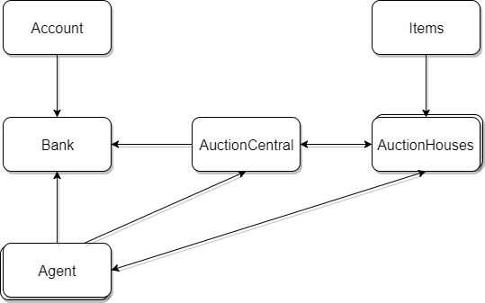

Slide 3
Class AuctionCentral extends Thread
public AuctionCentral(Socket socket)
Initializes a Thread with Sockets and differentiates the different serialized objects getting sent through the network.
public void run()
Listens for the different Objects going through the sockets on the network and controls the main AuctionCentral according to the commands given.
This is where most of the class happens, listens for commands from different servers eg. AuctionHouses, Bank and also clients like Agent.

Slide 4
Class AuctionHouses extends Thread
public void run()
Connects to the Bank and AuctionCentral servers.
Listens and sends commands over the network through Sockets.
This class is what keeps track of all of the Auction Houses and items inside of them. Each Auction House has an inventory of items to be bid upon, and the AuctionHouse is what keeps track of people’s bids, items they want, items in the store, etc.

Slide 5
Class Bank extends Thread
public Bank(Socket socket)
Initializes a bank server on the network using sockets.
public void run()
While this Thread is running, it is constantly listening for packets coming from AuctionCentral.
The bank keeps track of the user’s name, account number, bank key, and amount of money in the user’s bank account.
Users MUST register with the Bank and make an account if they want to use the PublicAuction.

Slide 6
Class Account extends HashMap
public Account(String name)
Takes a name as an input and opens a bank account for the user. The user will receive a bank number and a bank key.
When a user is trying to bid on an item, a request is sent through the bank back to Account to login.

Slide 7
Class Agent extends Thread
public Agent(String userName)
Initializes a new Agent with the given username.
The agent can communicate with almost every server on the network.
The agent listens for packets coming from the Bank, AuctionCentral, and AuctionHouses allows the user to communicate with the servers.
The agent is what allows the user to connect with the database, bid on items, purchase items, it can communicate with the bank to make/register an account, and when an item is purchased/bid it gets sent back to Agent.

Slide 8
Class Message implements Serializable
public Message(String msg)
Initializes a new message object with the given command msg.
The message object is our main means of communicating through the networks. Message is a serialized object that stores different Booleans and Strings that coordinate with certain commands. After a Message object is sent between networks, it gets read and the networks can act on the command accordingly.

